Slide 1

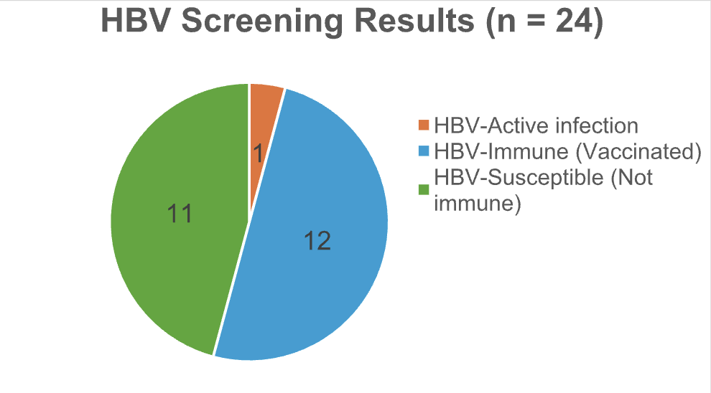
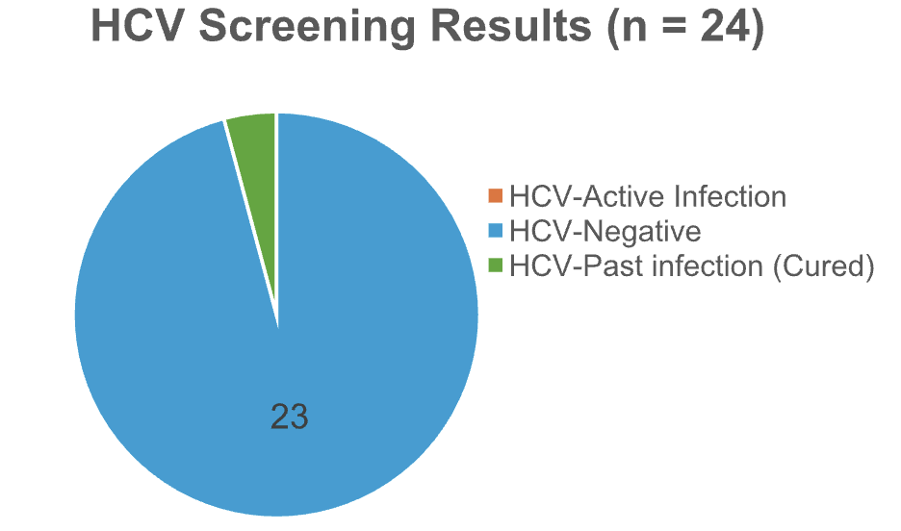
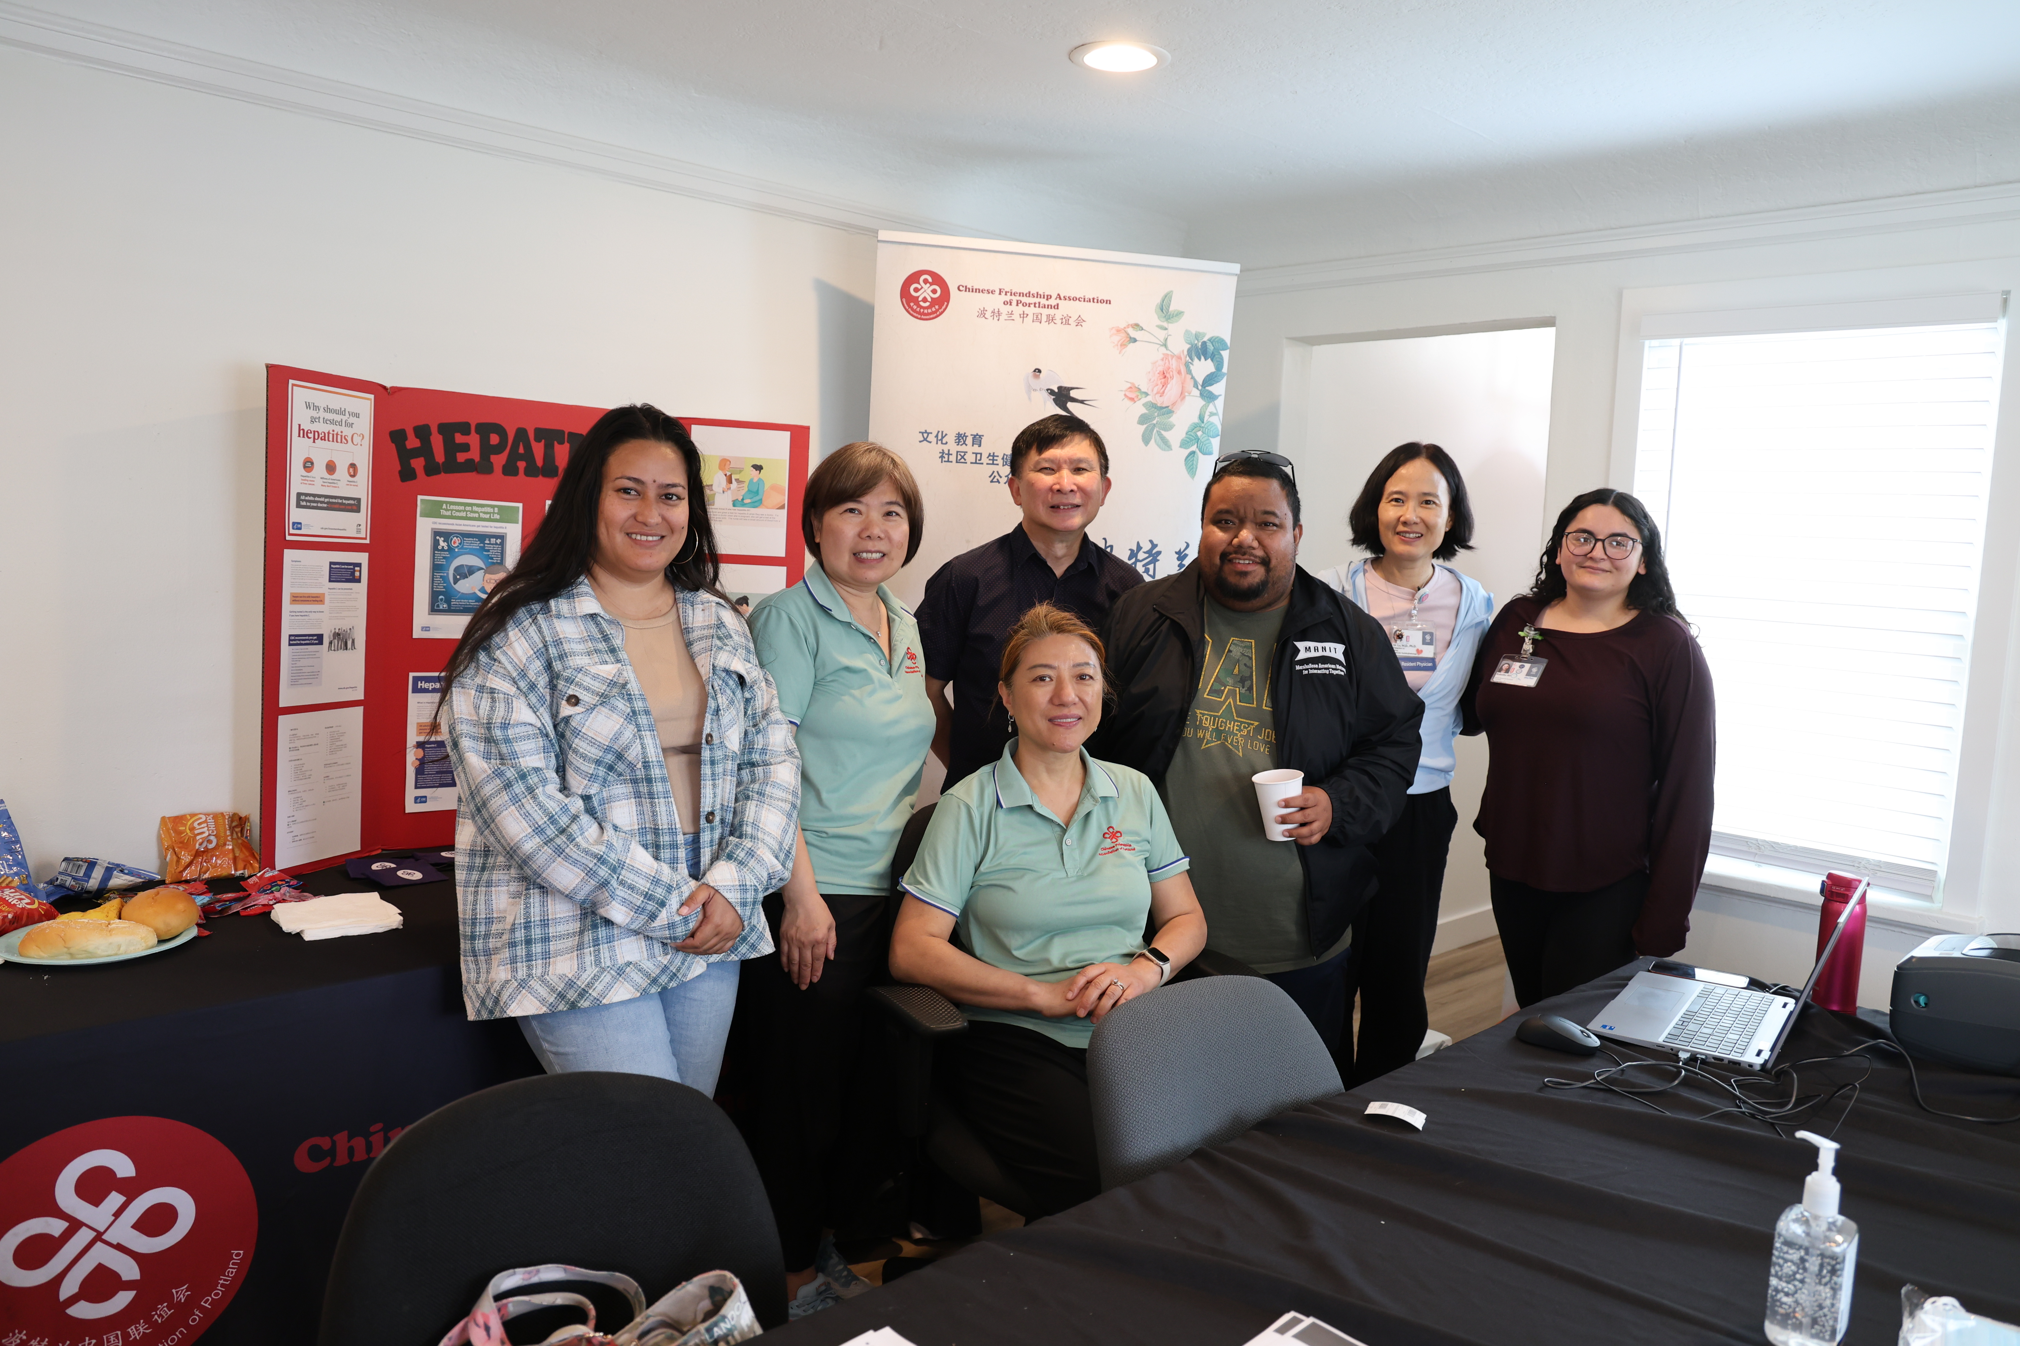

Tier 2: Serology and Molecular Screening for Hepatitis Viruses (HBV/HCV) in the AAPI Community Iris Zhao Program Director Chinese Friendship Association of Portland
Background
Results / Findings
Chronic liver disease and hepatocellular carcinoma (HCC) are rising in the U.S., disproportionately affecting Asian Americans and Pacific Islanders (AAPI). Though AAPI only make up 6% of the population, they account for ~60% of liver cancer cases. Chronic HBV and HCV infections are the leading risk factors for HCC. Barriers for AAPI include language, cultural stigma, healthcare access, and lack of awareness.
Seminars Overview
3 one-hour community seminars
52 unique attendees (ages 15-70)
Participant Demographics
Ethnicity: Asian 90%, Hispanic/Latino 4%, White 6%
Healthcare access: Private 69%, Government 19%, Free/low-cost 4%, Other 4%, None 6%
Baseline Knowledge
Had not heard of HBV/HCV: 10%
Already screened: 31%
Unsure if screened: 35%
Common barriers: lack of awareness, uncertainty about coverage
Outcomes
Knowledge gain: 92% felt significantly more knowledgeable
Satisfaction: 100% satisfied (77% very satisfied)
Willingness to screen: 65% → 98% post-seminar
Planned to schedule screening: 73%
Goals & Objectives
HBV:
1 active infection (low viral load, follow-up arranged).
12 immune (vaccinated), 11 susceptible (need vaccination).
HCV:
1 with cured past infection.
No active HCV infections detected.
Overall: 1 active HBV case, 0 active HCV cases; highlighted vaccination gap.
The overall aim of the project was to screen AAPI adults for HBV/HCV and provide culturally tailored education to reduce liver cancer risk.
The specific objectives were to:
Conduct ≥3 bilingual education seminars (English/Chinese).
Increase participant knowledge of HBV/HCV by at least 75%.
Screen ≥25 adults for HBV/HCV serology/genotyping.
Support 100% of positive cases in getting the care they need.
Future Direction
Expand outreach beyond Portland to other Oregon counties.
Advocate for vaccination among non-immune individuals.
Sustain program via:
Additional grants and funding
Capacity building (community health workers)
Project Design & Methods
Outreach: Social media campaigns engaging 2,000+ community members, leaders, and language groups
Education: Quarterly bilingual seminars led by OHSU experts
Evaluation: Pre/post surveys to track knowledge and willingness for screening
Screening: Free community clinics with HBV/HCV testing at OHSU clinical labs
Acknowledgements
Funding for this project was provided in part by the OHSU Knight Cancer Institute Community Partnership Program, a grant program that supports communities across Oregon in addressing local cancer-related needs. We also appreciate OHSU Department of Pathology for the technical support.
HBV/HCV blood screening day brought together AAPI community leaders with medical professionals from OHSU and Providence.

